Slide 1




A toolkit for Romani (Gypsy), Roma and Irish, Scottish and Welsh Traveller communities
O
@GypsyTravellerM
The Traveller Movement
c
The Traveller Movement

Slide 2


The Mission: Operation Traveller Vote (OTV) puts Romani (Gypsy), Roma and Irish, Scottish and Welsh Traveller communities front and centre in local democracy.

Slide 3
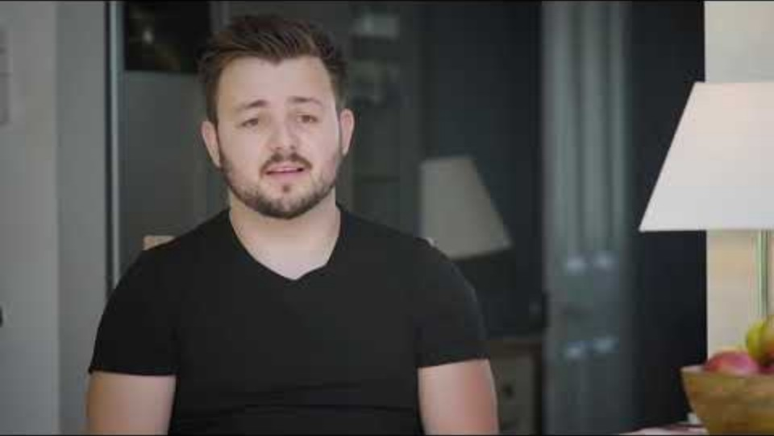
Why We Are Here
Watch this short film to understand why the journey of Operation Traveller Vote is so important.

Slide 4

Select a topic to explore the toolkit
Ethnic Monitoring & Data
Educational Resources
Policy Briefs

Slide 5
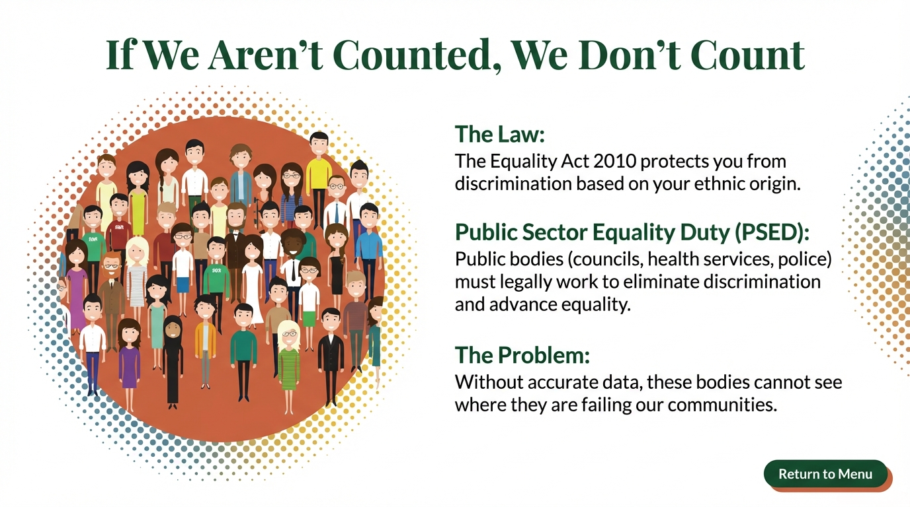

Slide 6
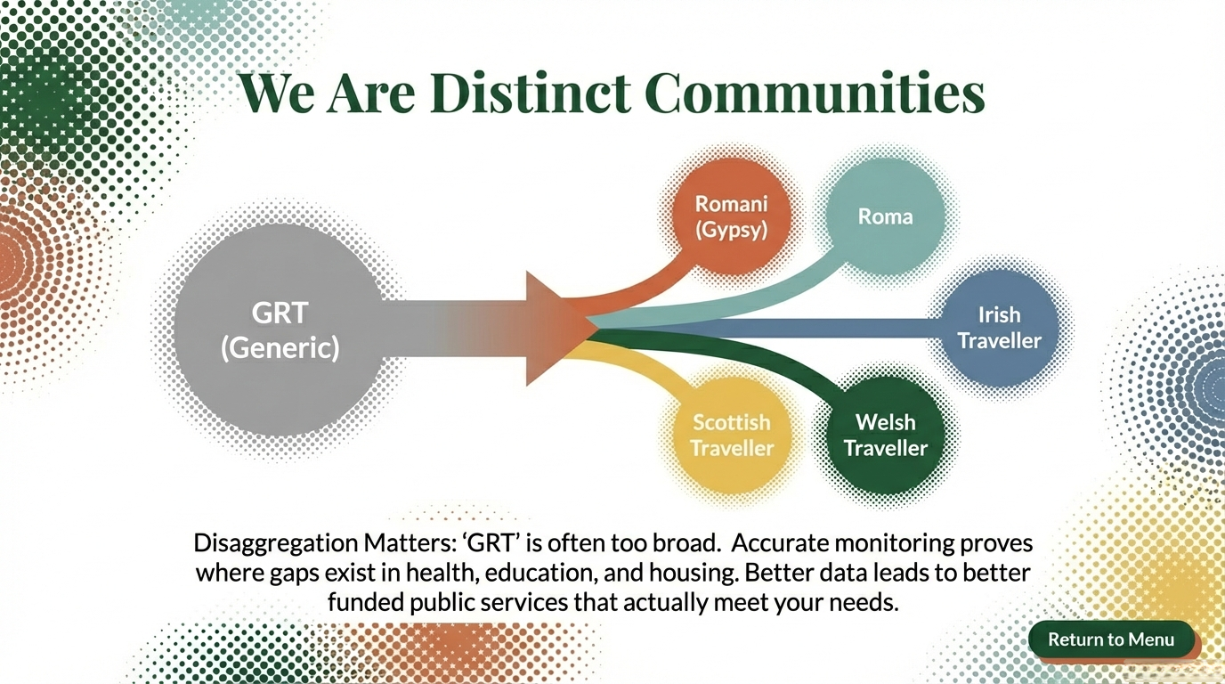
We Are Distinct Communities
Disaggregation Matters: ‘GRT’ is often too broad. Accurate monitoring proves where gaps exist in health, education and housing. Better data leads to better public services that actually meet your needs.

Slide 7
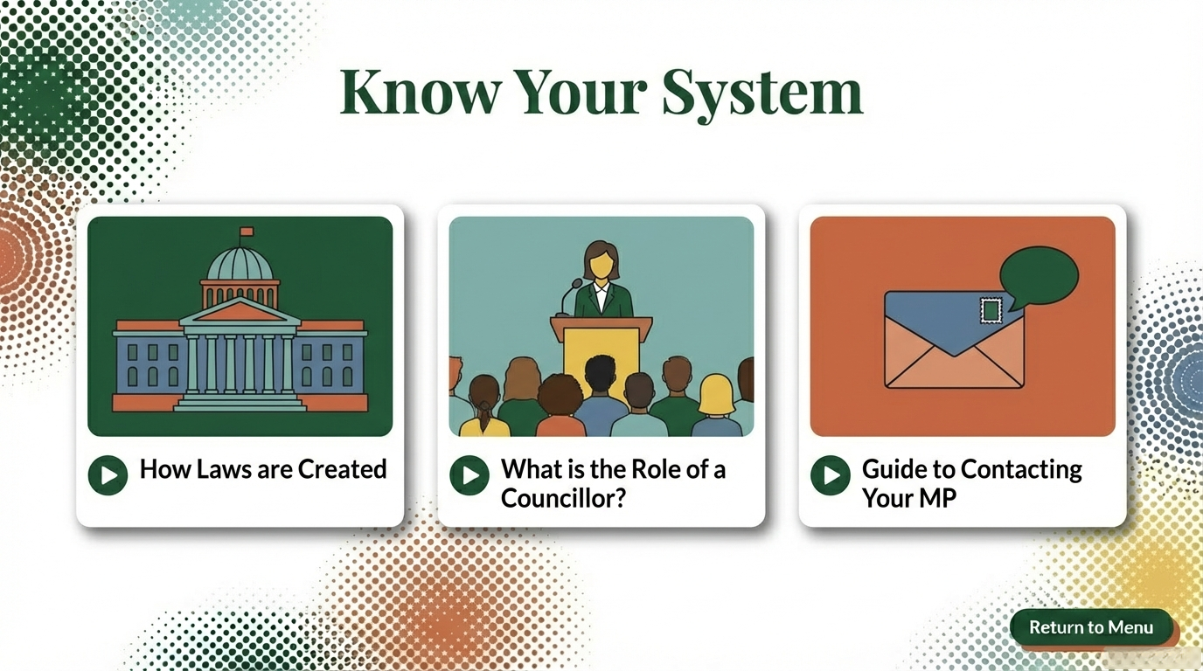
Know Your Systems

Slide 8
Policy Briefs and Resources
Bureaucratic Barriers:
Democratic barriers for Romani (Gypsy), Roma and Irish Traveller communities
Mistrust of State Institutions:
Democratic barriers for Romani (Gypsy), Roma and Irish Traveller communities
Perception to voting in the UK:
Democratic barriers
When Politics Pushes People Away:
Alienation, Language and Politicians
Pyramid of Need:
Democratic barriers for Romani (Gypsy), Roma and Irish Traveller communities

Slide 9

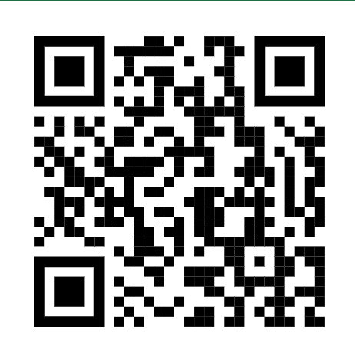

Slide 10
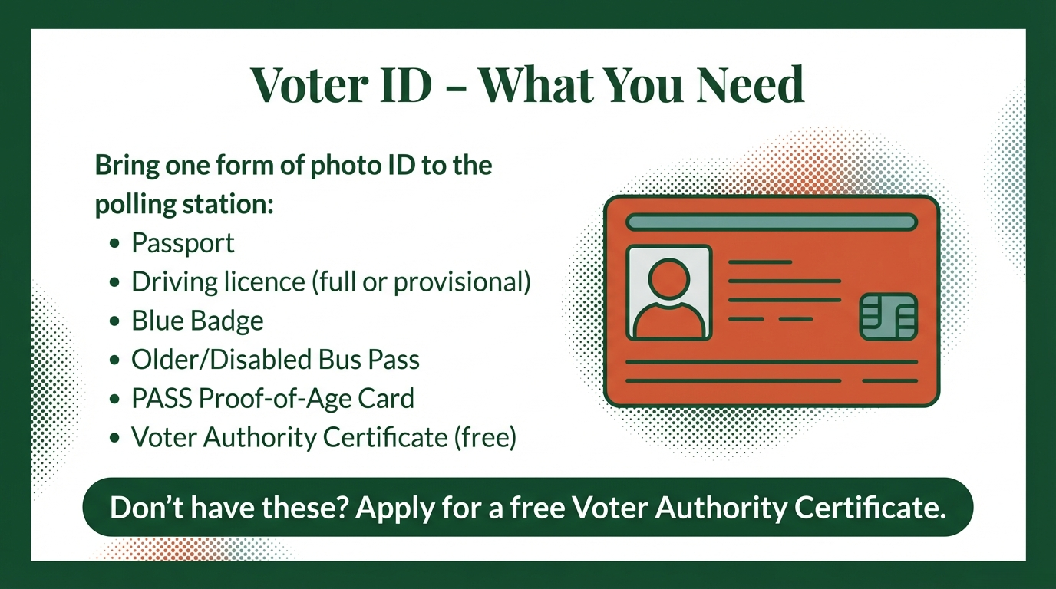

Slide 11
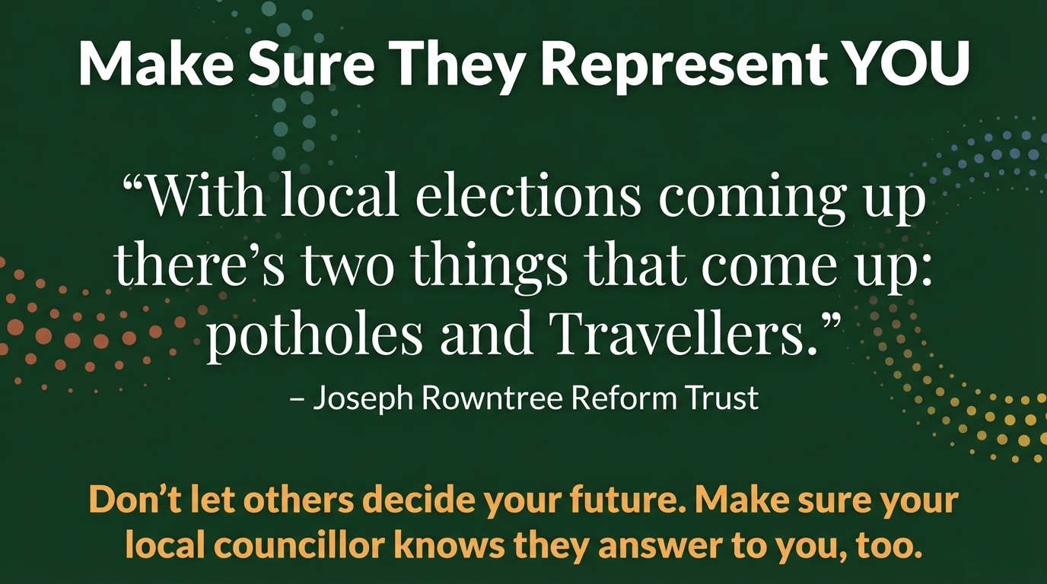

Slide 12


Website: www.travellermovement.org.uk
Twitter/X: @GypsyTravellerM
Instagram: The Traveller Movement
Facebook: The Traveller Movement
LinkedIn: The Traveller Movement (TM Official)
TikTok: @travellermovement
Registered Charity: 1107113
Company Limited by Guarantee no: 4038939
Copyright Traveller Movement 2026

